Slide 1

WELCOME TO
MY CAB
Enterprise Systems Development | UFCF85-30-3
Sprint 2 Submission | 4 July 2022

Slide 2





OUR TEAM
Hassan Rizvee
Mohamed Hazim
Shimaz Shihab
Aminath Nishfa
Haleemath Shuhudha

Slide 3

AGENDA
➡
DESIGN AND PLANNING
MODIFICATIONS MADE TO DATABASE DESIGN
DESIGN AND PLANNING
Database ER-diagram
➡
SPRINT REVIEW
GANTT CHART
➡
TASK OVERVIEW
Backend architecture
➡
TASK OVERVIEW
Make booking functionality
➡
➡
MY CAB Screenshots
➡
CHALLENGES

Slide 4

DESIGN AND PLANNING
Made changes to our initial database design to normalize the database
Normalization is the process of organizing data in a database.
this involves constructing tables and defining relationships between those tables in accordance with rules.
Designed the necessary tables and attributes, including data types and primary and foreign keys.
Modifications made to Database Design

Slide 5
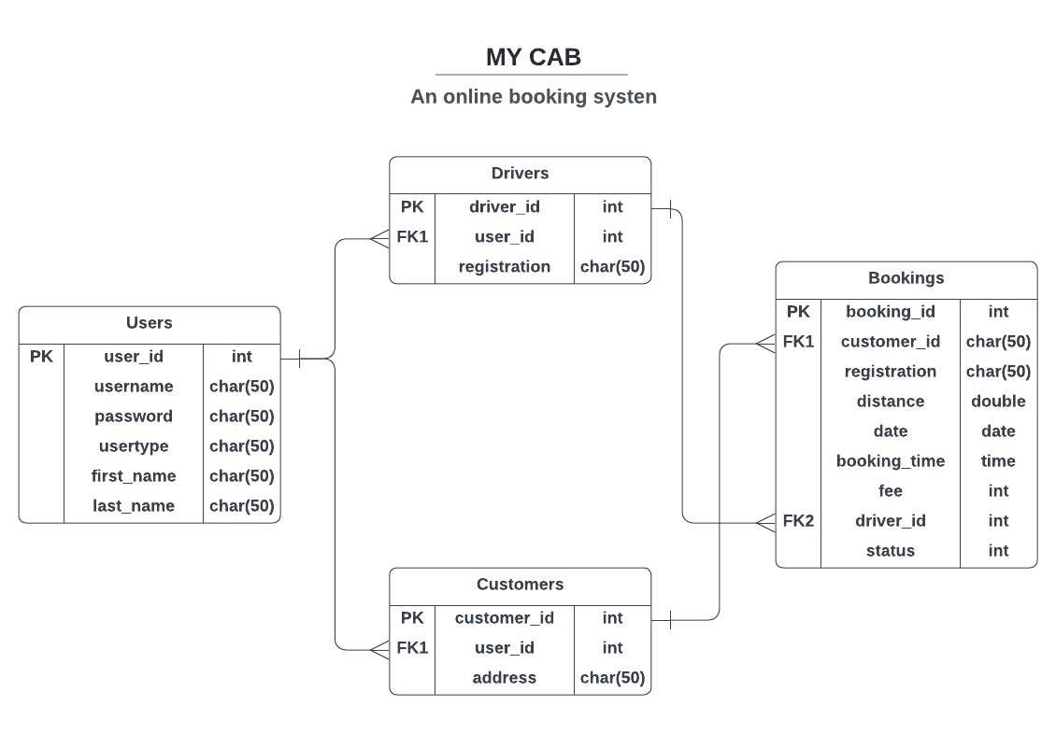
DESIGN AND PLANNING
Database ER-diagram

Slide 6
TASK OVERVIEW
Backend architecture
All of the required classes have been created.
DAO - Data Access Object - are used to manage data storage connections (typically database)
DAO classes that require database communication have been implemented.
Table data is manipulated, read, inserted, deleted, and edited using CRUD operations. The majority of the table's CRUD operations have been implemented.

Slide 7

TASK OVERVIEW
For entering the necessary data, a user interface is accessible.
When a user submits, a query check is run to see if the provided username is already in the database.
If the validation check is successful and the user's other information is correct, the user is redirected to the login page.
Register functionality

Slide 8



DESIGN AND PLANNING
Make Booking functionality
A user interface is provided for entering the necessary booking information
The Google Maps Places API is used to retrieve addresses for the start and end locations
And, using Google Maps Distance Matrix API, the provided addresses are used to calculate the total distance
Which is then utilized to determine the booking amount

Slide 9
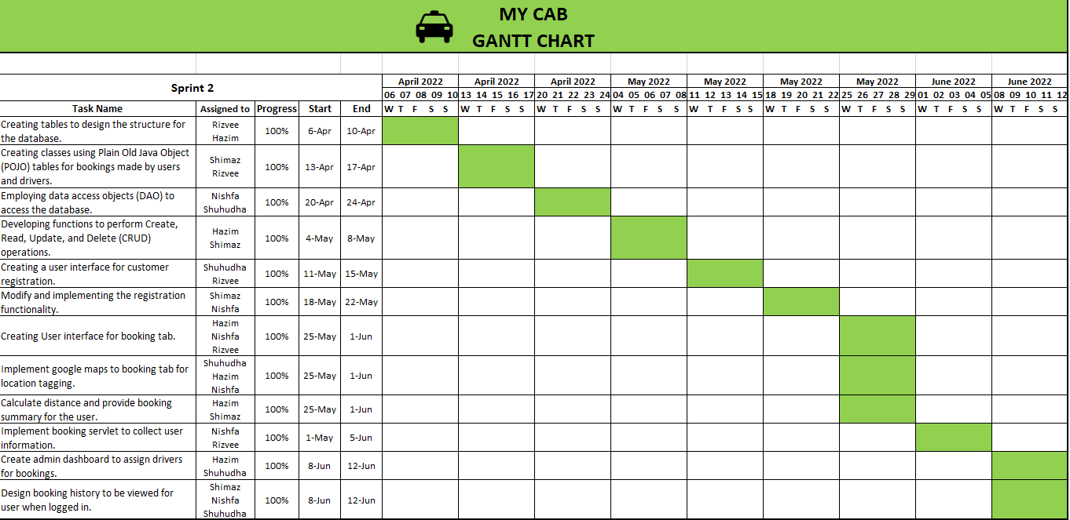
SPRINT REVIEW - GANTT CHART

Slide 10
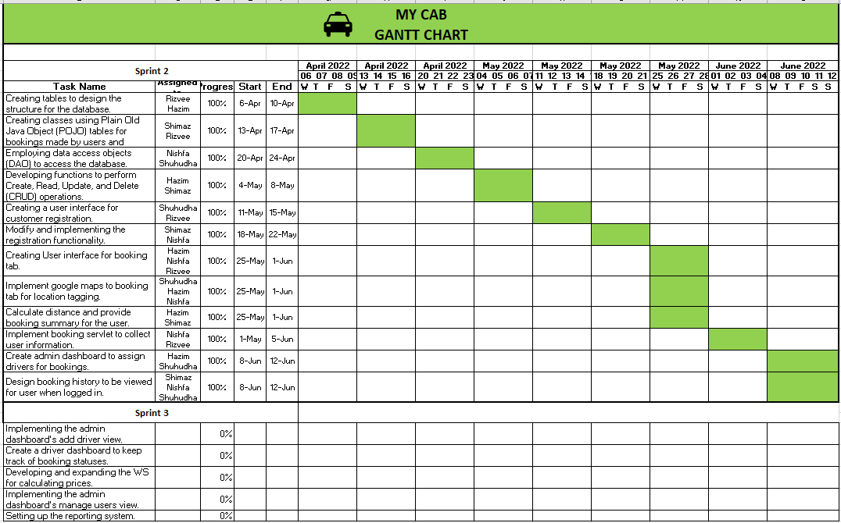
SPRINT REVIEW - GANTT CHART

Slide 11

MY CAB SCREENSHOTS

Slide 12
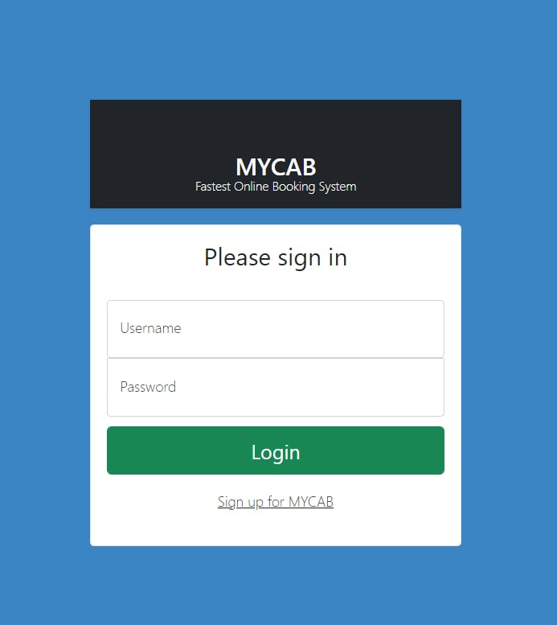
SIGN-IN

Slide 13
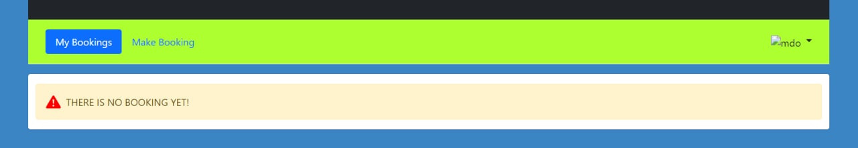
MY BOOKINGS

Slide 14
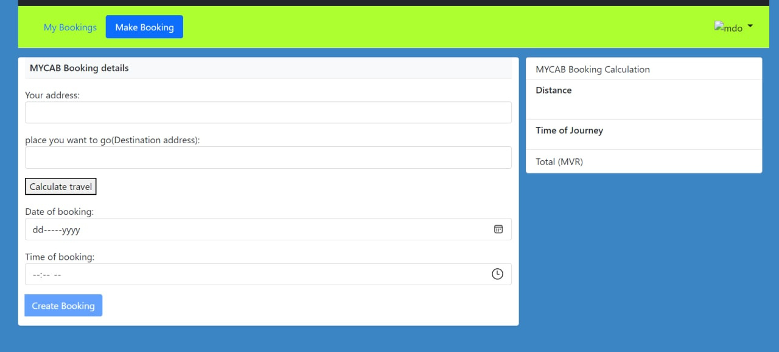
MAKE BOOKING

Slide 15
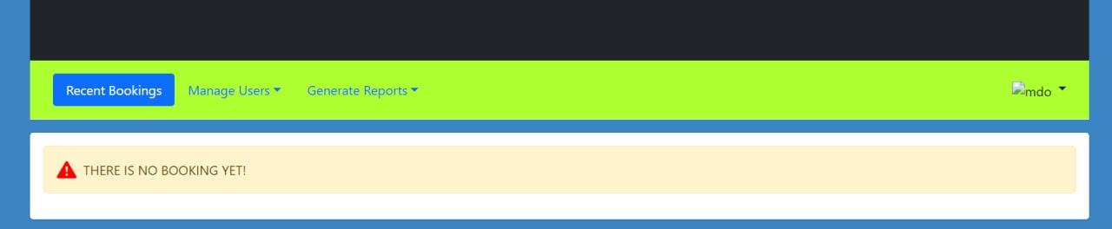
RECENT BOOKINGS

Slide 16
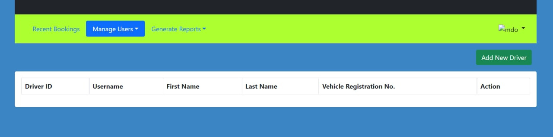
MANAGE USERS

Slide 17
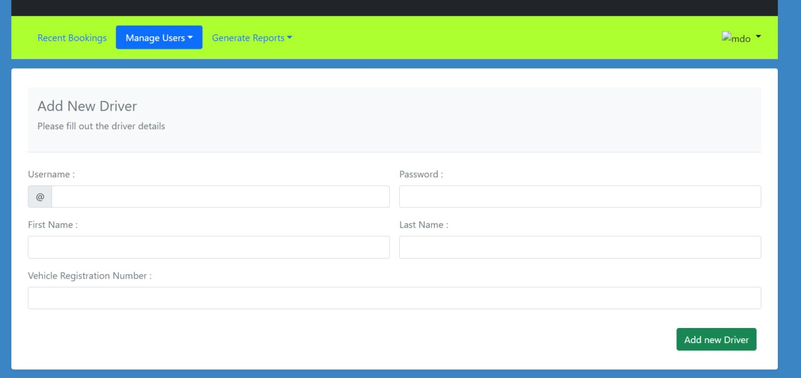
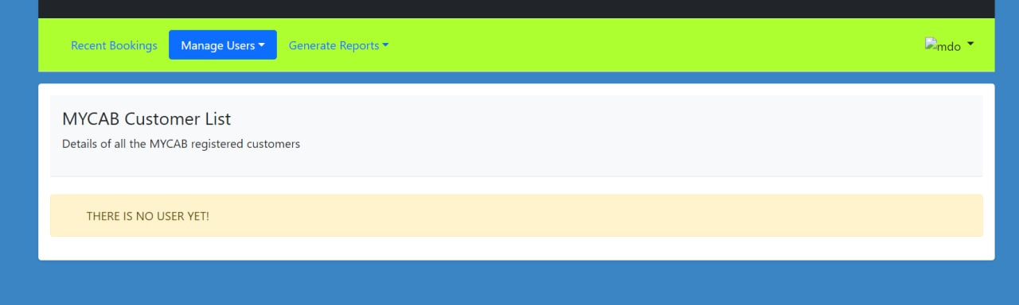
ADD NEW DRIVER

Slide 18
CUSTOMER LIST

Slide 19
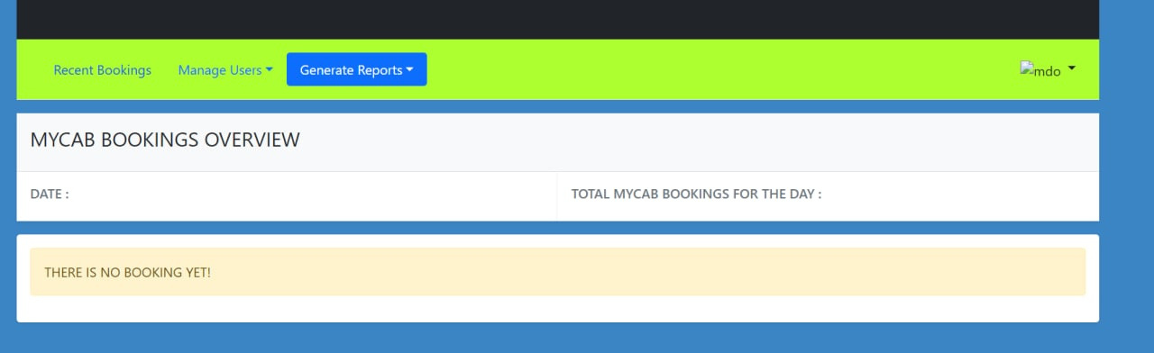
BOOKINGS OVERVIEW

Slide 20




CHALLENGES
Initially, couldn’t pass special characters through java servlets to the database
All the members of the group were not that familiar with git operations
Due to error messages, it consumed a lot time to time to debug and implement
Meeting up was difficult due to team members' busy schedules

Slide 21
Thank You

